Slide 1

Engineering Graphics
ME 2000
Development of Surfaces
Dr. Vikash Kumar

Slide 2
Introduction
Graphical method of obtaining the area of the surfaces of a solid.
When a solid is opened out and its complete surface is laid on a plane, the surface of the solid is said to be developed.
folded
Development of Solid
Solid
unfolded

Slide 3
Introduction
Example
Prism – Made up of same number of rectangles as sides of the base
One side: Height of the prism
Other side: Side of the base
Cylinder – Rectangle
One side: Circumference of the base
Other side: Height of the cylinder
h
φd
πd
T. L.
Pyramid – Number of triangles in contact

Slide 4
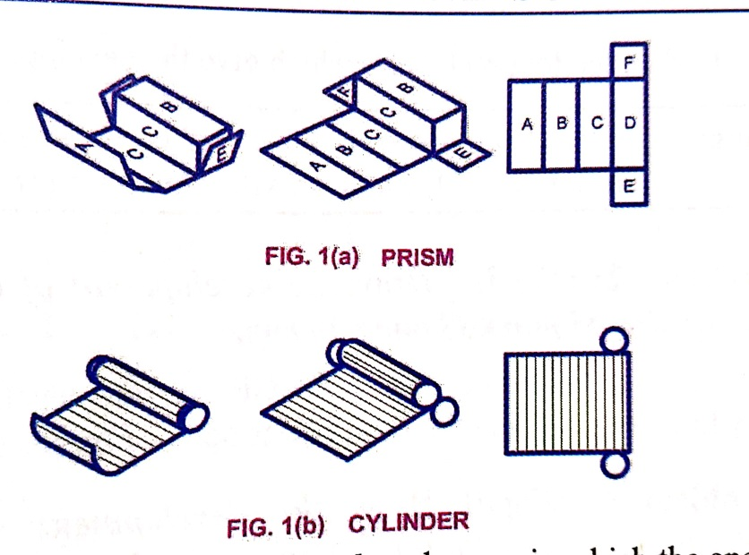
Method of Development
Parallel line Development
This method is used to develop cubes, prisms and cylinders in which all the edges of generators of lateral surfaces are parallel to each other.
Prisms and cylinders roll out into rectangular stretch-outs by this method.
Prism
Cylinder

Slide 5
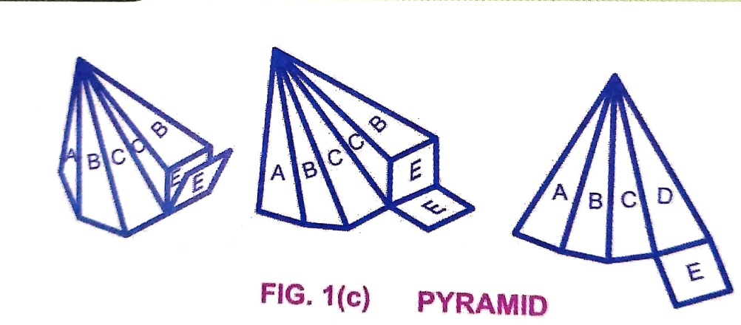
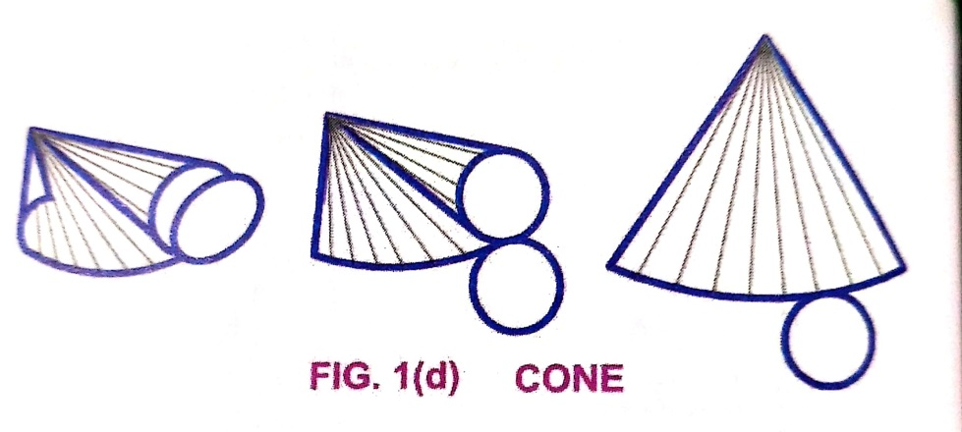
Method of Development
Radial line Development
This method is used to develop Pyramids and Cones in which apex is taken as center.
The true length of the slant edge or generator taken as radius for development of surface.
Pyramid
Cone

Slide 6
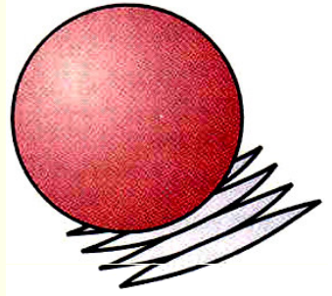
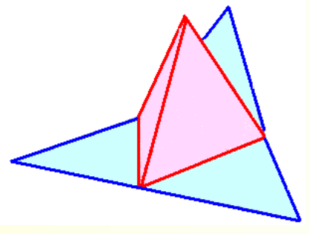
Method of Development
Approximate Development
This method is used to develop double–curved surfaces like sphere.
Approximate developments are constructed through the use of conical sections of the object.
Triangulation Development
Used for polyhedrons and wrapped surfaces.
Triangulation for single curved surfaces increases in accuracy through the use of smaller and more numerous triangles.

Slide 7
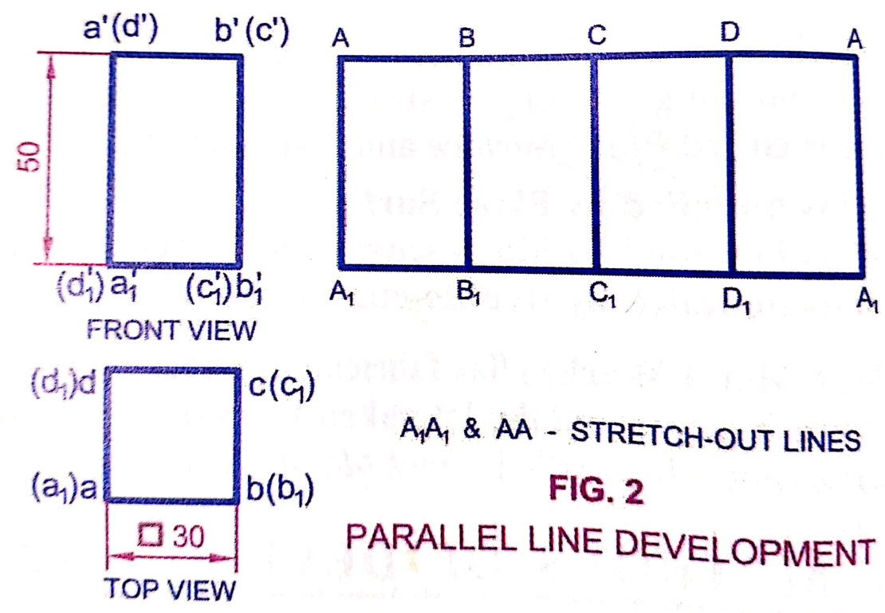
Development of Surfaces
Draw the development of the lateral surfaces of a right square prism of edge of base 30 mm and axis 50 mm long.
Draw the top and front view
Development consist of 4 equal rectangle of size 50 mm X 30 mm in contact and in sequence
Darken the four rectangle which give the development of the lateral surface of prism
Stretch out lines
Parallel line development
In the development of the lateral surfaces, the starting and closing edges should be same to obtain the closed object.
Note

Slide 8
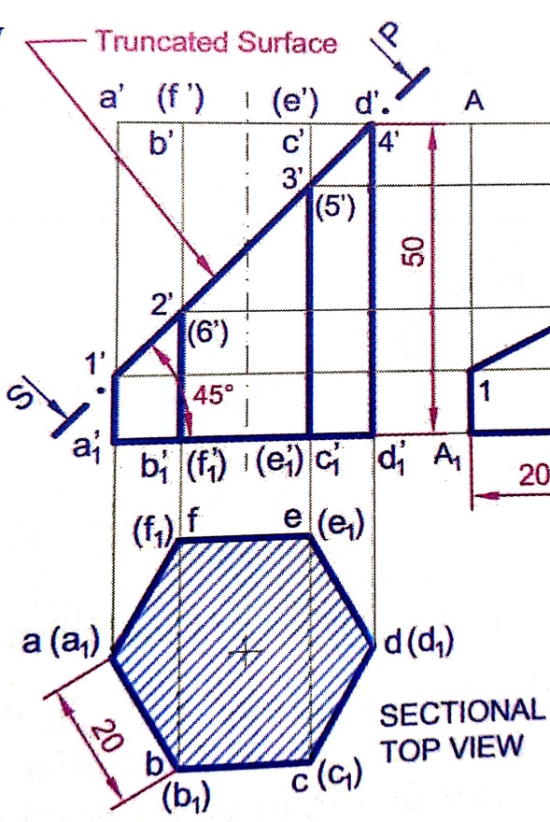
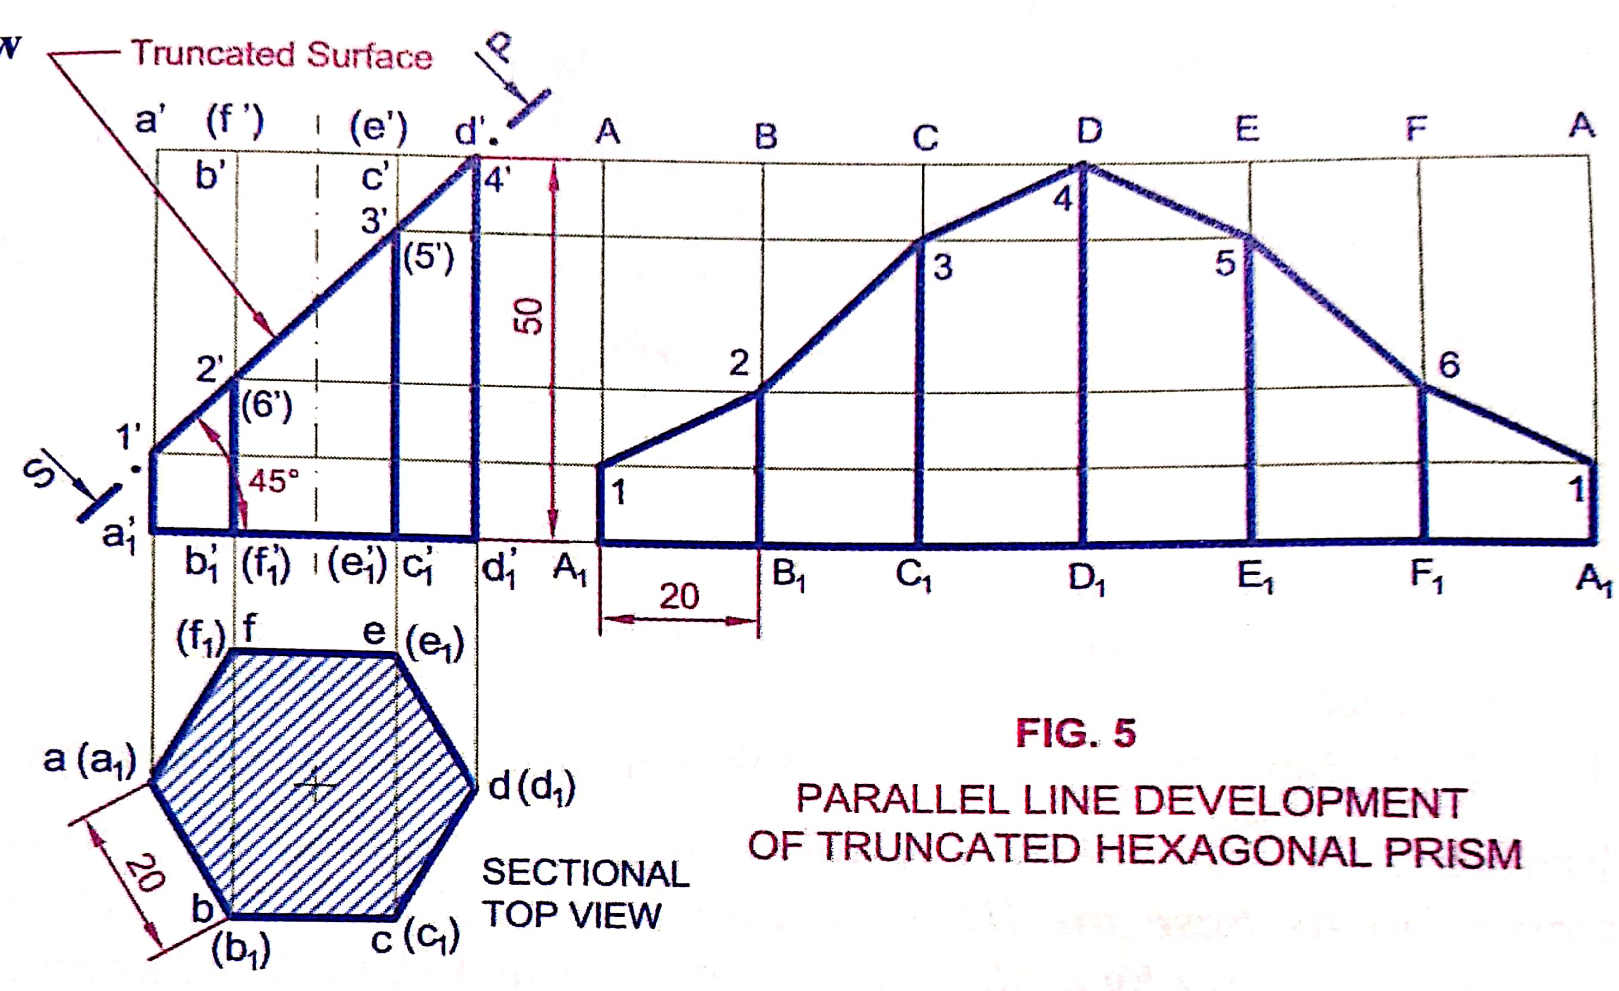
Development of Surfaces
A hexagonal prism, edge of base 20 mm and axis 50 mm long, rests with its base on HP such that one of the rectangular faces is parallel to VP. It is cut by a plane perpendicular to VP, inclined at 45° to HP and passing through the right corner of the top face of the prism. Draw the sectional top view and develop the surface of truncated prism.

Slide 9
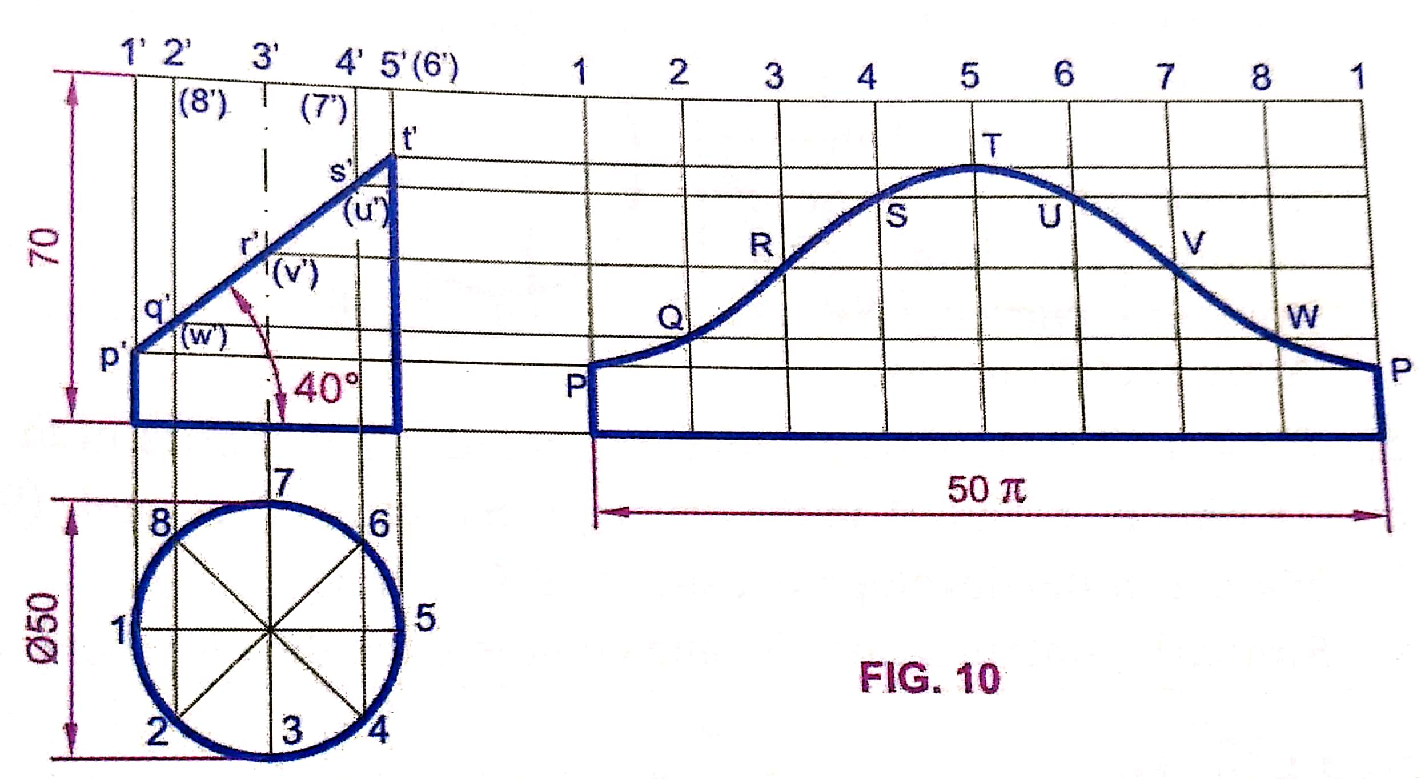
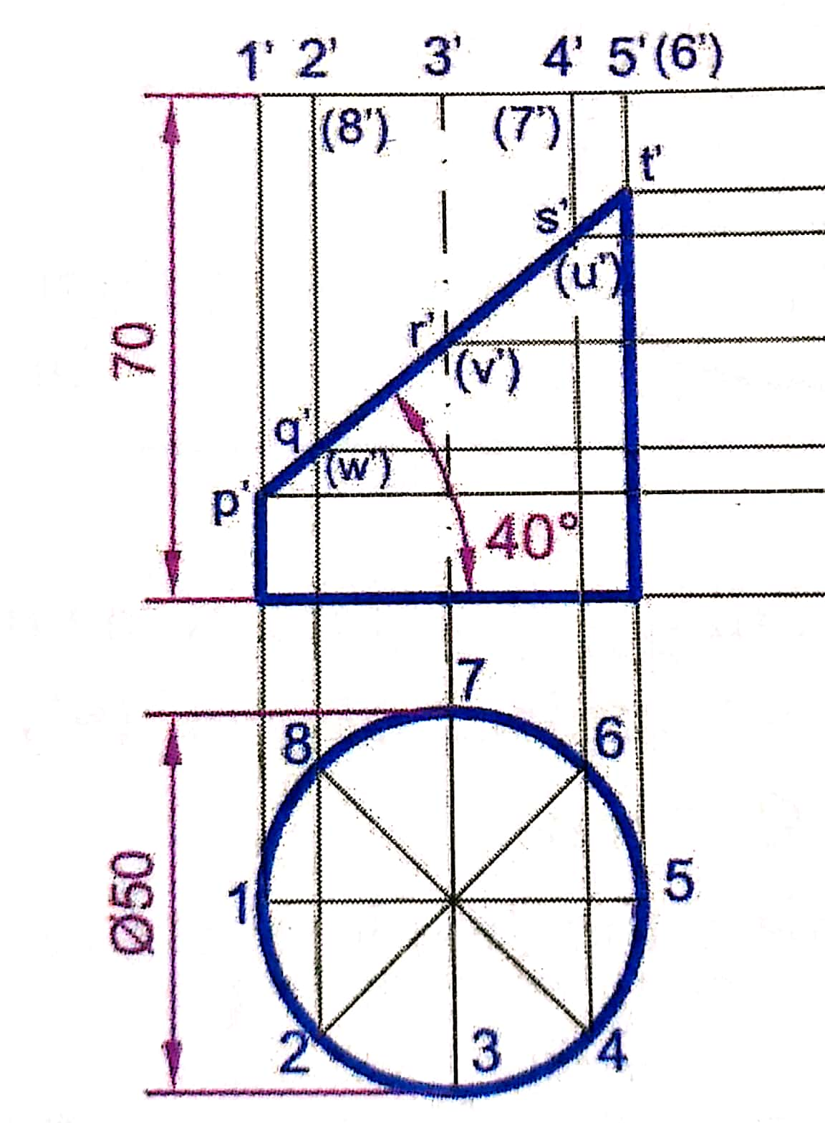
Development of Surfaces
Draw the development of the lateral surface of the lower portion of a cylinder of diameter 50 mm and axis 70 mm when sectioned by a plane inclined at 40° to HP and perpendicular to VP and bisecting the axis.

Slide 10
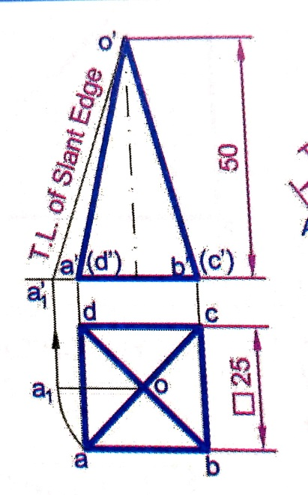
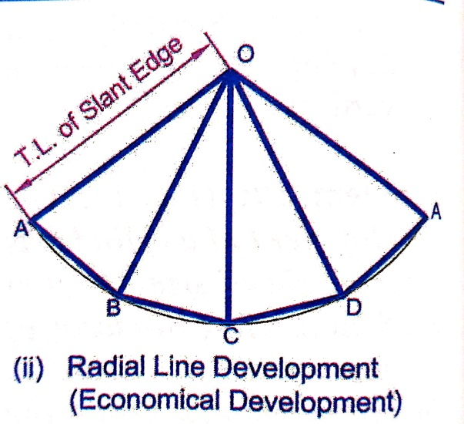
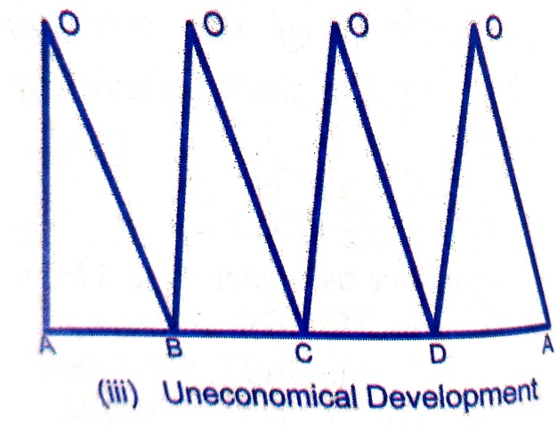
Development of Surfaces
Draw the development of the lateral surface of a square pyramid, side of base 25 mm and height 50 mm, resting with its base on HP and edge of base parallel to VP.
Draw the top and front view
To find the true length of the slant edge
If the top view of a slant edge of a pyramid is parallel to XY, then the FV of that edge will give its true length and Vice-versa
O as center and o’a1’ as radius draw an arc.
On this arc, mark 4 divisions i.e. chord AB=BC=CD=DA= 25 mm.
Uneconomic development

Slide 11
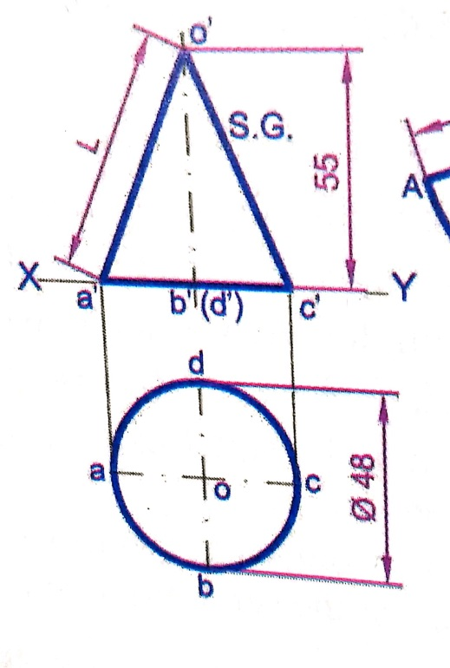
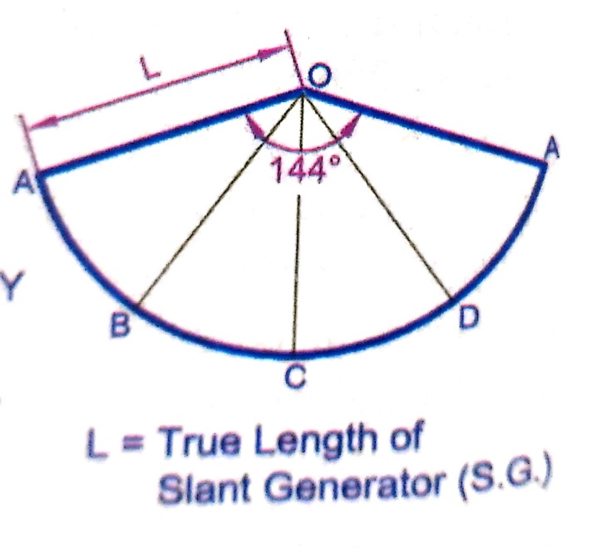
Development of Surfaces
Draw the development of the lateral surface of a cone of base 48 mm and altitude 55 mm.
Draw the top and front view.
In top view, oa is parallel to XY. Hence o’a’ = L = True length of slant generator
Development of the lateral surface of cone is a sector of a circle of radius = L
Angle subtended by the arc at the center is ϴ.
ϴ = 360° x r/L

Slide 12
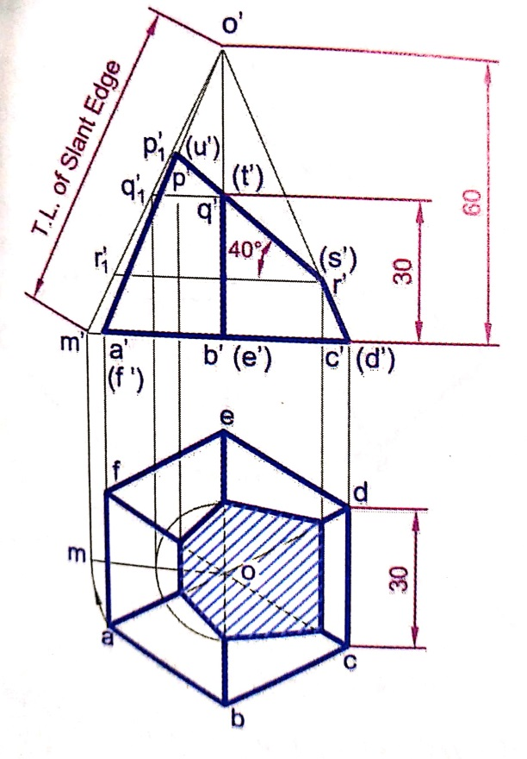
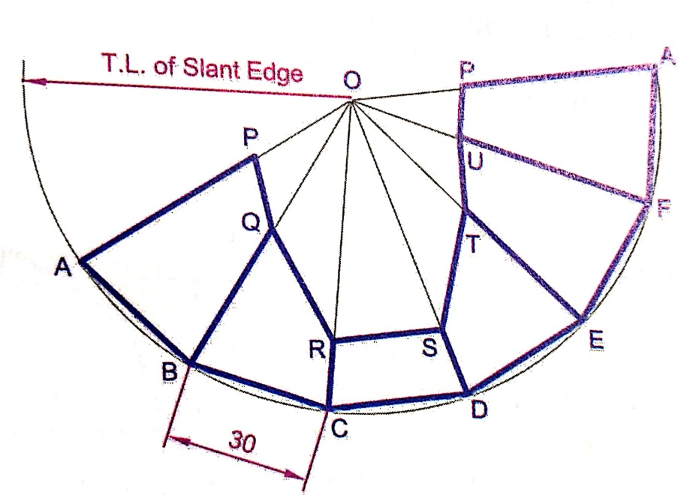
Development of Surfaces
A regular hexagonal pyramid of side of base 30 mm and height 60 mm is resting vertically on its base on HP such that two sides of the base a perpendicular to VP. It is cut by a plane inclined at 40° to HP and perpendicular to VP. The cutting plane bisects the axis of the pyramid. Obtain the development of lateral surface of the truncated pyramid.

Slide 13
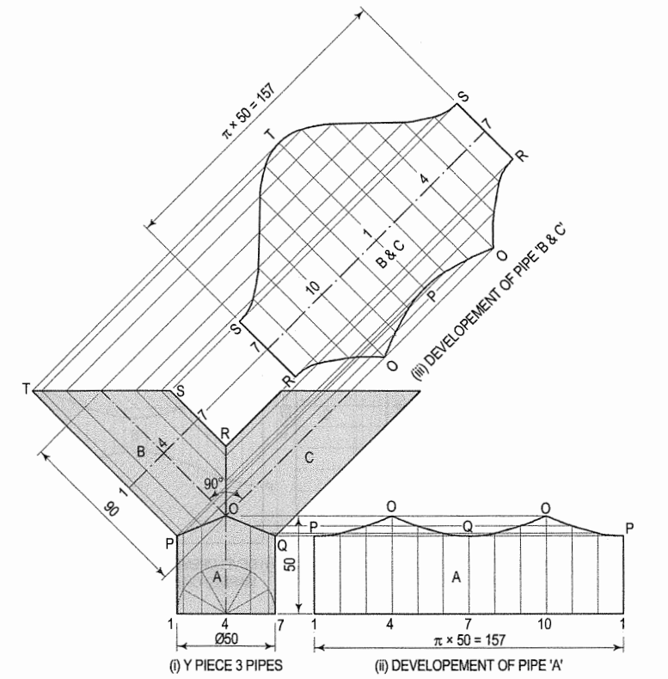
Three cylindrical pipes of 50 mm diameter form a Y-piece as shown in the front view in fig (i). Draw the development of the surface of each pipe.

Slide 14
Thank You

